Slide 1
Sponsored Programs Administration Resource & Knowledge Series
INTRODUCTION TO SPaRKS
Presented by:
Laurianne Torres, Joan Jarvis, Doshie Walker, Dr. Andrew Daire

Slide 2
OVERVIEW
General Information
SPaRKS Program Framework
Course Syllabus
Exploring Research Administration…from CONCEPT to COMMERCIALIZATION
Laurianne Torres

Slide 3
OVERVIEW
General Information
SPaRKS is a 10-session, 4-month long professional development program
Designed around the CRA Body of Knowledge, meant to give an introduction to basic concepts of research administration: from Concept to Commercialization
SPaRKS meets biweekly May 2 – August 29
WHEN: 10am to 12pm (every other Wednesday)
WHERE: University Tower, 2nd floor training room
INTRODUCTION TO SPARKS

Slide 4
OVERVIEW
General Information
SPaRKS is a certificate-based professional development program
To be eligible for the SPaRKS certificate
Complete the Pre-/Post- SPaRKS evaluation
Attend all SPaRKS sessions
Only ONE session may be missed
Missed session must be made up within 2 weeks
SPaRKS make-up sessions for previous sessions are available just before the next sequential session
INTRODUCTION TO SPARKS

Slide 5
OVERVIEW
General Information
What to expect:
SIGN IN!!! Be ON TIME!
2 hours of instruction, with a ~10 minute break
Question/Answer period, as time allows
Think About Its…
Followed by Intermediate and Advanced series
Interested in sitting for the CRA Exam?
CRA Study Group meeting concurrently throughout SPaRKS Basics 2012
INTRODUCTION TO SPARKS

Slide 6
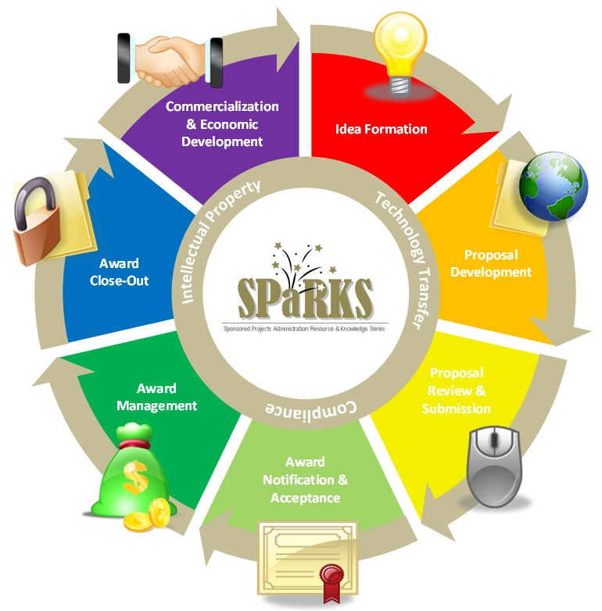
OVERVIEW
SPaRKS Program Framework
INTRODUCTION TO SPARKS

Slide 7
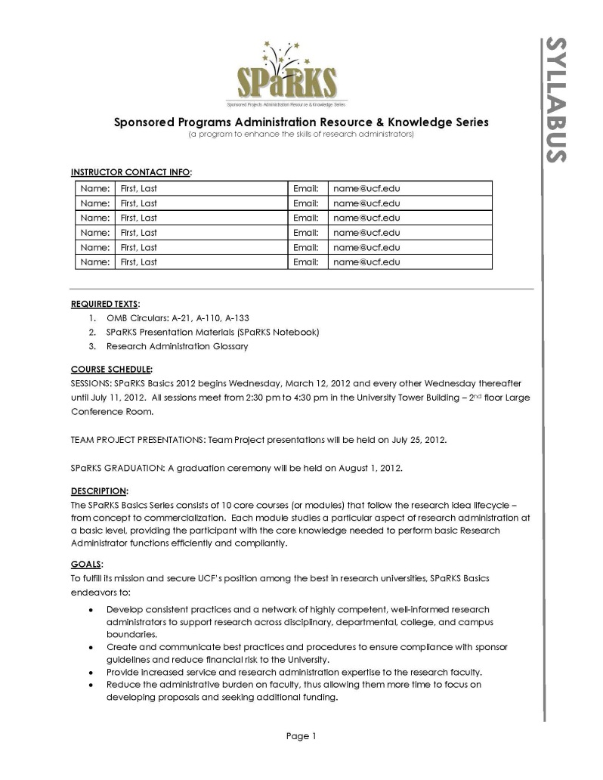
OVERVIEW
SPaRKS Course Syllabus
INTRODUCTION TO SPARKS

Slide 8
QUESTIONS or COMMENTS?

Slide 9
BENEFITS OF RESEARCH
Exploring Research Administration…from CONCEPT to COMMERCIALIZATION
Joan Jarvis

Slide 10
BENEFITS OF RESEARCH
What is a Research Administrator?
INTRODUCTION TO SPaRKS

Slide 11
BENEFITS OF RESEARCH
What is a Research Administrator?
Resource Locator, Scout
Interpreter
Reviewer
Motivator, Catalyst, Advocate
Compliance Expert
Team Builder, Broker
Gatekeeper
Enforcer
INTRODUCTION TO SPaRKS

Slide 12
BENEFITS OF RESEARCH
What is a Research Administrator?
Research Administrators represent their institutions in diverse matters related to:
Research Development
Grants and Contracts Administration
Regulatory Compliance
Institutional Policies & Procedures
Commercialization
Economic Development
INTRODUCTION TO SPaRKS

Slide 13
BENEFITS OF RESEARCH
What is Research?
re·search (n) - A systematic investigation, including research development, testing and evaluation, designed to develop or contribute to generalizable knowledge.
The importance of research may vary according to kind, especially whether basic or applied.
INTRODUCTION TO SPaRKS

Slide 14
BENEFITS OF RESEARCH
What is Applied Research?
Applied research purpose is mainly to solve problems
Not for the sole purpose of generating new knowledge
End results often have an immediate use for application or commercialization
Conducted by universities and industries
Note: Another recognized type is Developmental
INTRODUCTION TO SPaRKS

Slide 15
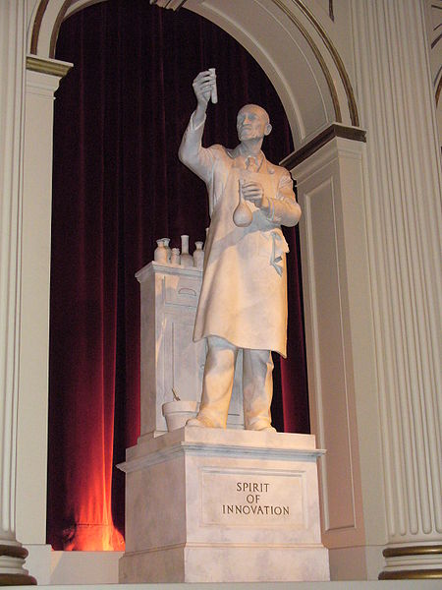
BENEFITS OF RESEARCH
The Value of Research
Innovation: A valued characteristic within our nation.
A personification of innovation as represented by a statue in The American Adventure in the World Showcase pavilion at Epcot.
INTRODUCTION TO SPaRKS

Slide 16
BENEFITS OF RESEARCH
The Value of Research
INTRODUCTION TO SPaRKS

Slide 17
BENEFITS OF RESEARCH
The Value of Research
Improves the quality of our lives
Solves problems
Leads to new discoveries
Leads to new technologies
Satisfies our curiosity
Leads to economic development
INTRODUCTION TO SPaRKS

Slide 18
QUESTIONS or COMMENTS?

Slide 19
HISTORY & TRENDS
Exploring Research Administration…from CONCEPT to COMMERCIALIZATION
Joan Jarvis

Slide 20
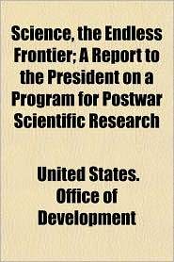
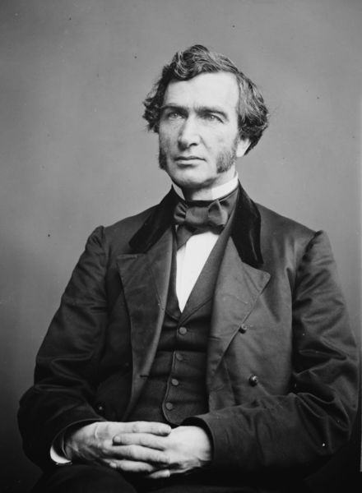
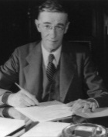
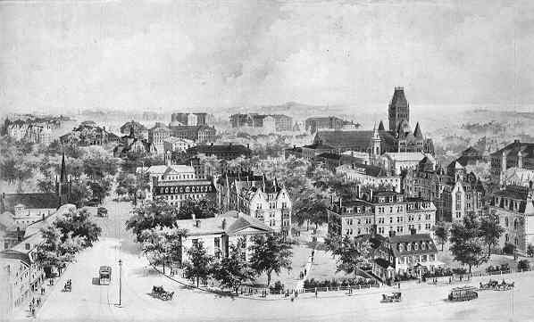
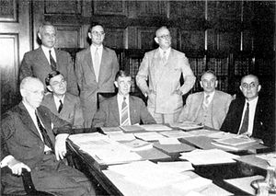
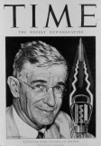
HISTORY & TRENDS
Morrill Land-Grant Acts are passed to fund a system of industrial colleges, one in each state.
Soviets launch Sputnik I and the Space Race begins causing a rapid influx of federal funding for research at colleges and universities
1862 and 1890
Dr. Bush responds with
Science: The Endless Frontier
October 1957
May 1941
July 1945
Office of Scientific Research & Development (OSRD) is formed, Dr. Bush appointed Director
June 1940
Colleges (Harvard, Yale, Princeton & William and Mary) are established in the Colonies, modeled after Cambridge and Oxford in England.
National Defense Research Committee (NDRC) is formed, Dr. Bush appointed Chair
University research offices grow (34 in 1960 to 97 in 1970), recognizing the need for the establishment of policy to manage research
Early 1600’s
1961-1970
Early 1600s
Present Day
WWI conflict erupts,
Vannevar Bush (NRC) points out lack of cooperation between civilian scientists and the military
President Roosevelt writes to Dr. Bush and asks –
What can Government do now and in the future to aid research activities by public and private organizations?
National Science Foundation is established
OSTP is established & OMB issues
Circular A-110
Compliance and unfunded mandates continue to be the theme,
as is electronic research administration
1914
1950
1976
1980s-late 1990s
18th and 19th Centuries
November 1944
OMB issues
Circular A-21
1958
Industrial Revolution brings
Westward Expansion
Railroads
Mechanization
Farming
Civil War
1959
NCURA is established.
Council of Governmental Relations (COGR) is established
1948
INTRODUCTION TO SPARKS

Slide 21
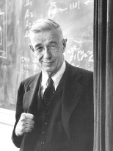
HISTORY & TRENDS
Dr. Vannevar Bush – an American engineer
Best known for his work on analog computing, his role in the Manhattan Project, the establishment of Raytheon, and the idea of memex (predecessor of the WWW)
Vice President and Dean of Engineering at MIT (1932-1938)
First presidential science advisor
INTRODUCTION TO SPARKS

Slide 22
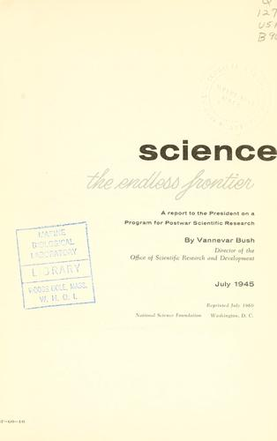
HISTORY & TRENDS
Science: The Endless Frontier
There must be stability of funds over a period of years so that long-range programs may be undertaken.
Agency should be composed of citizens selected only on the basis of their interest in and capacity to promote the work of the agency.
The agency should promote research through contracts or grants to organizations outside the Federal Government.
Support of basic research in the public and private colleges, universities, and research institutes must leave the internal control of policy, personnel, and the method and scope of the research to the institutions themselves.
Agency must be responsible to the President and the Congress.
INTRODUCTION TO SPARKS

Slide 23
HISTORY & TRENDS
National Science Foundation – Mission Statement:
“The National Science Foundation (NSF) is an independent federal agency created by Congress in 1950 ‘to promote the progress of science; to advance the national health, prosperity, and welfare; to secure the national defense…’ With an annual budget of about $6.06 billion, we are the funding source for approximately 20 percent of all federally supported basic research conducted by America's colleges and universities. In many fields such as mathematics, computer science and the social sciences, NSF is the major source of federal backing.”
From the About Us section of the National Science Foundation’s website: http://www.nsf.gov/about/glance.jsp
INTRODUCTION TO SPARKS

Slide 24
HISTORY & TRENDS
Meeting Today’s Challenges
Increased Regulation
Focus on compliance
Unfunded Mandates
Managing the challenge
Technology Era
Doing more with less
INTRODUCTION TO SPARKS

Slide 25
HISTORY & TRENDS
Future R&D Investment
Healthcare
Renewable Energy
Natural Resources
Global Competition
Population Growth
Global Pandemics
STEM careers
While it is difficult to speculate what the future holds, there are some economic and social drivers that could impact how the U.S. government invests in research.
INTRODUCTION TO SPARKS

Slide 26
HISTORY & TRENDS
Looking Ahead
President Obama’s Charge to ‘Out-Build, Out-Innovate, Out-Educate’ the World
INTRODUCTION TO SPARKS

Slide 27
QUESTIONS or COMMENTS?

Slide 28
RELATIONSHIP BUILDING
SERVANT LEADERSHIP
Exploring Research Administration…from CONCEPT to COMMERCIALIZATION
Doshie Walker

Slide 29
Topics we will cover
Origin of Servant Leadership
Characteristics of Servant Leadership
Practicing Servant Leadership
Paradoxes
Summary

Slide 30
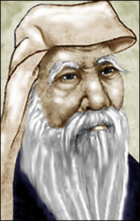
Origins
The concept of servant-leadership is thousands of years old.
600 B.C. Lao Tzu:
The greatest leader forgets himself and attends to the development of others.
375 B.C.(4th Century B.C.) Chanakya’s Arthashastra:
The [leader] shall consider as good, not what pleases himself but what pleases his subjects.
First Century A.D., Jesus of Nazareth:
But the greatest among you shall be your servant (Matthew 23:11); The one who is the greatest among you must become like the youngest, and the leader like the servant. (Luke 22:26)
1970’s Robert K. Greenleaf:
The servant-leader is servant first… It begins with the natural feeling that one wants to serve, to serve first.
Notes:
Speaking Points:
Servant-Leadership, as a concept, has its origins tracing back to the earliest history
It is not a religious concept
It is, however, supported by most of the world’s major religions
I am a Christian and while many people point to Jesus as the epitome of servant-leadership, I wish I could boast it originated as a Christian concept. Instead, I can only say that it is the only leadership practice fully aligned with the teachings of our religion, as it is with most of the world’s major religions. Greenleaf ites one of the greatest servant-leaders he ever knew to be his personal friend, Rabbi Abraham Joshua Heschel, a “liberal activist”.
4th Century B.C.
Chanakya or Kautilya, the famous strategic thinker from ancient India, wrote about servant leadership in his 4th century B.C. book Arthashastra:
"the king [leader] shall consider as good, not what pleases himself but what pleases his subjects [followers]" "the king [leader] is a paid servant and enjoys the resources of the state together with the people".
NOTE: His lessons were not always Servant-leadership focused. Some quotes downright in opposition, but in many areas, he understood the key concepts of Servant-Leadership as with the quote cited.
600 B.C.
In approximately 600 B.C., the Chinese sage Lao Tzu wrote The Tao Te Ching, a strategic treatise on servant leadership: FORTY-NINE The greatest leader forgets himself And attends to the development of others. Good leaders support excellent workers. Great leaders support the bottom ten percent. Great leaders know that The diamond in the rough Is always found “in the rough.” (Quote from The Way of Leading People: Unlocking Your Integral Leadership with the Tao Te Ching.)

Slide 31
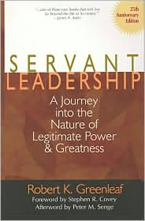
The Servant Leadership Concept
In the book Servant Leadership,
Robert Greenleaf (1991) introduces
the concept of the leader as servant,
an idea he credits to his reading of
Herman Hesse's short novel Journey
to the East in the 1960s.
*Mythical journey, sponsored by an Order central character Leo- the servant
Notes:
Greenleaf considered that one of his “life markers” came in the early 1960’s with the reading and reflection on a novel by Hermann Hesse--Journey to the East. Briefly summarized from his own writing (Greenleaf, Servant Leadership, p. 7, RG), we capsule the story’s essence:
Among a traveling band on a mythical journey to the East, Leo is a menial servant of chores, spirit, and song. Into the journey, when Leo disappears, the group falls into disarray and the journey is abandoned. Years later, the narrator discovers that Leo the servant was in fact the titular head of the Order that had commissioned the journey: the lowly servant was in fact, its guiding spirit, a great and noble leader.
From Leo’s journey, and sixty years of his own experience, Greenleaf concluded that the meaning of the story was that great leaders must first serve others.
Do you have a book, a person, an experience that has greatly influenced the foundational concepts and direction of your life?

Slide 32
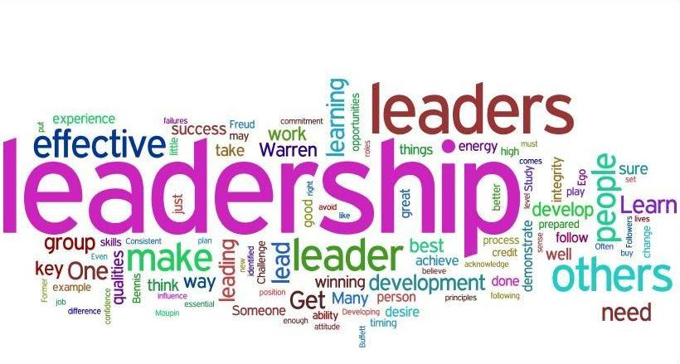
Servant -lEADERSHIP
According Greenleaf (1970), servant-leadership is a management style in which leading and serving are in harmony, and there is thoughtful interaction with the environment.
Notes:
According Greenleaf (1970), servant-leadership is a management style in which leading and serving are in harmony, and there is thoughtful interaction with the environment.
A servant-leader is someone who has a strong wish to serve as well as a strong ability to lead and, most importantly, is able to combine both in such a way that they strengthen each other positively.

Slide 33
Servant / Service
Definitions of Servant:
one who serves, or does services, voluntarily or on compulsion; a person who is employed by another for menial offices, or for other labor, and is subject to his command; a person who labors or exerts himself for the benefit of another, his master or employer; a subordinate helper…
a person in the service of another.
one who expresses submission, recognizance, or debt to another:
a person working in the service of another…
in a subordinate position…
a person who is hired to work for another…
Definitions of Service:
An act of assistance or benefit; a favor
an act of helpful activity; help; aid.
work done by one person or group that benefits another
The performance of work or duties for a superior or as a servant
be of service, to be helpful or useful
Notes:
Speaking Notes:
No need to read entire slide
Want to call attention to the highlighted (bolded) words
READ THROUGH SOME
Emphasis is on OTHERS, helping, aiding, benefitng, serving, submission, etc… all for other people
Humility is key – usefulness to others, selflessness
References for Definitions:
American Psychological Association (APA):
Servant. (n.d.). Dictionary.com Unabridged (v 1.1). Retrieved July 11, 2008, from Dictionary.com website: http://dictionary.reference.com/browse/Servant
Chicago Manual Style (CMS):
Servant. Dictionary.com. Dictionary.com Unabridged (v 1.1). Random House, Inc. http://dictionary.reference.com/browse/Servant (accessed: July 11, 2008).
Modern Language Association (MLA):
"Servant." Dictionary.com Unabridged (v 1.1). Random House, Inc. 11 Jul. 2008. <Dictionary.com http://dictionary.reference.com/browse/Servant>.

Slide 34
Definitions of Leader:
a person or thing that leads.
a guiding or directing head, as of an army, movement, or political group.
One that leads or guides.
One who is in charge or in command of others.
One who heads a political party or organization.
One who has influence or power, especially of a political nature.
a person who rules or guides or inspires others
a person who is in front or goes first
a person who is the head of, organizes or is in charge (of something)
The head …of any body… as of a tribe, clan, or family; a person in authority who directs the work of others…
Notes:
Speaking Notes:
Pretty much what you would expect from defining a leader
Guide, Direct, Influence or Power, Head of, organizes, in charge, authority, directs…..

Slide 35
Characteristics of Servant Leadership
Servant
Leader
Notes:
Speaking Points:
President / CEO of Greenleaf center for 25 years
Author of hundreds of publications on Servant-Leadership
Founded the Spears Center

Slide 36
Characteristic Breakout
Breaking out Spears’ characteristics into 3 dimensions…
Servant
Leader
SERVANT-LEADER
Listening
Empathy
Healing
Stewardship
Commitment to People
Building Community
Awareness
Persuasion
Conceptualization
Foresight
Notes:
Speaking Points:
President / CEO of Greenleaf center for 25 years
Author of hundreds of publications on Servant-Leadership
Founded the Spears Center
All characteristics are relevant to Servant-Leadership
After reviewing these characteristics and reading many interpretations of Spears’ work and Greenleaf’s original texts, it seems to me these characteristics can be easily recognized and remembered by the two dimensions of SERVANT and LEADER

Slide 37
Characteristic Breakout
Breaking out Spears’ characteristics into 3 dimensions…
Servant
Leader
SERVANT-LEADER
Listening
Empathy
Healing
Stewardship
Commitment to People
Building Community
Awareness
Persuasion
Conceptualization
Foresight
Notes:
Speaking Points:
All characteristics are relevant to Servant-Leadership
After reviewing these characteristics and reading many interpretations of Spears’ work and Greenleaf’s original texts, it seems to me these characteristics can be easily recognized and remembered by the two dimensions of SERVANT and LEADER
Awareness. General awareness, and especially self-awareness, strengthens the servant-leader. Awareness also aids one in understanding issues involving ethics and values. It lends itself to being able to view most situations from a more integrated, holistic position. As Greenleaf observed:“ Awareness is not a giver of solace—it is just the opposite. It is a disturber and an awakener. Able leaders are usually sharply awake and reasonably disturbed. They are not seekers after solace. They have their own inner serenity.”
Persuasion. Another characteristic of servant-leaders is a primary reliance on persuasion rather than positional authority in making decisions within an organization. The servant-leader seeks to convince others rather than coerce compliance. This particular element offers
one of the clearest distinctions between the traditional authoritarian model and that of servant-leadership. The servant-leader is effective at
building consensus within groups.
Conceptualization. Servant-leaders seek to nurture their abilities to “dream great dreams.”The ability tolook at a problem (or an organization)
from a conceptualizing perspective means that one must think beyond day-to-day realities. For many managers this is a characteristic
that requires discipline and practice. Servant-leaders are called to seek a delicate balance between conceptual thinking and a day-to-day
focused approach.
Foresight. Foresight is a characteristic that enables the servant leader to understand the lessons from the past, the realities of the present, and the likely consequence of a decision for the future. It is also deeply rooted within the intuitive mind. Foresight remains a
largely unexplored area in leadership studies, but one most deserving of careful attention.

Slide 38
Characteristic Breakout
Breaking out Spears’ characteristics into 3 dimensions
Servant
Leader
SERVANT-LEADER
Listening
Empathy
Healing
Stewardship
Commitment to People
Building Community
Awareness
Persuasion
Conceptualization
Foresight
Notes:
Speaking Points:
All characteristics are relevant to Servant-Leadership
After reviewing these characteristics and reading many interpretations of Spears’ work and Greenleaf’s original texts, it seems to me these characteristics can be easily recognized and remembered by the two dimensions of SERVANT and LEADER
Listening. Leaders have traditionally been valued for their communication and decision-making skills. While these are also important skills
for the servant-leader, they need to be reinforced by a deep commitment to listening intently to others. The servant-leader seeks to identify the will of a group and helps clarify that will. He or she seeks to listen receptively to what is being said. Listening, coupled with regular periods of reflection, is essential to the growth of the servant-leader.
4. Empathy- Empathy. The servant-leader strives to understand and empathize with others. People need to be accepted and recognized for their special and unique spirits. One assumes the good intentions of coworkers and does not reject them as people, even if one finds it necessary to refuse to accept their behavior or performance.
Healing- Healing. One of the great strengths of servant-leadership is the potential for healing one’s self and others. Many people have broken
spirits and have suffered from a variety of emotional hurts. Although this is part of being human, servant-leaders recognize that they also have an opportunity to “help make whole” those with whom they come in contact. In “The Servant as Leader” Greenleaf writes:“There is something subtle communicated to one who is being served and led if implicit in the compact between servant-leader and led is the understanding that
the search for wholeness is something they share.”
MIDDLE
Stewardship. Peter Block has defined stewardship as “holding something in trust for another.” Robert Greenleaf ’s view of all institutions
was one in which CEOs, staffs, and trustees all played significant roles in holding their institutions in trust for the greater good of society. Servant leadership, like stewardship, assumes first and foremost a commitment to serving the needs of others. It also emphasizes the use of openness and persuasion rather than control.
Commitment to the growth of people. Servant-leaders believe that people have an intrinsic value beyond their tangible contributions as workers. As a result, the servant-leader is deeply committed to the growth of each and every individual within the institution.
The servant-leader recognizes the tremendous responsibility to do everything possible to nurture the growth of employees.
Building community. The servant leader senses that much has been lost in recent human history as a result of the shift from local communities
to large institutions as the primary shaper of human lives. This awareness causes the servant-leader to seek to identify some means for
building community among those who work within a given institution. Servant-leadership suggests that true community can be created
among those who work in businesses and other institutions. Greenleaf said: “All that is needed to rebuild community as a viable
life form for large numbers of people is for enough servant-leaders to show the way, not by mass movements, but by each servant-leader
demonstrating his own unlimited liability for a quite specific community- related group.”

Slide 39
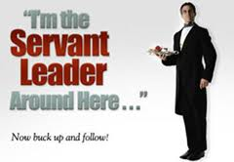
Translating the concepts into real-world practice

Slide 40
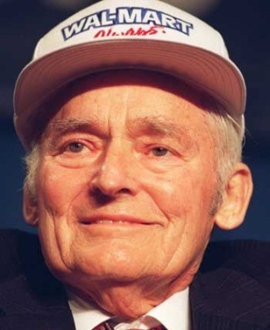
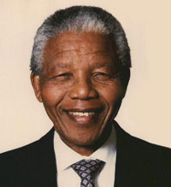
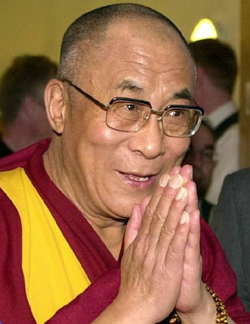
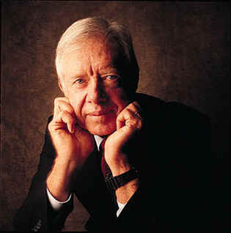
Individuals
Some examples of modern Servant-Leaders…
Sam Walton
Nelson Mandela
Jimmy Carter
The Dalai Lama
Countless Unknown
†
Notes:
Speaking Notes:
Herb Kelleher: Helped load baggage on Thanksgiving day, has been seen dressing up as Elvis for fun for the staff
Howard Behar: Retired in 1999, but in 2001, the CEO asked him back as interim president because the company had begun “to lose focus on the greater good” (Autry) and so they brought in servant-leadership.
Sam Walton – Wal-Mart has its issues today, but one of Sam’s most reiterated quotes was, “If you take care of your people, your people will take care of the customer and the business will take care of itself.”
Jimmy Carter – Long after leaving his presidency, he has been marked by hard work and constant contributions to causes like Habitat for Humanity. As one reporter put it, “In a world where power is often equated with force, Jimmy Carter reminds us that what endures is the power of example.” (http://community.seattletimes.nwsource.com/archive/?date=20000119&slug=4000096)
Countless Unknown – Remember, the very concept of Servant-Leadership necessitates a lack of pride and ego. It is not self-centered. So many of the world’s greatest Servant-Leaders go unknown.

Slide 41
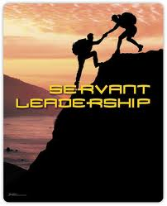
“A servant-leader loves people, and wants to help them”.
http://www.youtube.com/watch?v=bj73s4dqoUk

Slide 42
What is the connection to Research Administration
Notes:
At the 40th anniversary of SRA International conference: 2007
Origin of the profession
How it has evolved from one of service to leadership
As a profession, we need to focus on the development of relationships and to be mindful of the responsibilities that we hold
As research administrators we must serve as a resource to our researchers, provide leadership to fulfill the servant function without impeding the advancement of research.

Slide 43
History of Service
Funding Sources
Making copies
Mailing proposals
Requesting guidelines
Preparing budgets
The Office of Management and Budget (OMB) Circular A21 in the United States, created the need for additional monitoring of awards, which increased the services required from research administration offices.
Notes:
Research administration as a profession was founded on the need for service and the efficient delivery of our "product"--research.
In the early years of federally sponsored research, little oversight other than financial compliance was required by sponsors.
The service that was needed from the research office usually consisted of searching for funding sources, requesting guidelines, preparing budgets, making copies, and mailing proposals. At that time, these were the services needed to allow researchers to focus on writing proposals and conducting funded activities.
In time, proper stewardship of federal research funds took on greater scope and significance, as evidenced by multiple revisions of the Office of Management and Budget (OMB) Circular A21 in the United States. With this came the need for additional monitoring of awards, which increased the services required from research administration offices.

Slide 44
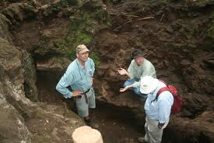
Servant and Leader
Servant
Leader
Servant and Leader
Notes:
Research Administrators role of servant and leader.
Servant:
Helping to find funding sources, Apply for Funding, Receive Research Funding, Manage Research funding
Reviewing guidelines and proposals
Providing advice on post award management and
many more activities
Leader:
We lead by suggesting and preparing policies
informing institutional leadership of trends and requirements
and a multitude of other activities
Being both service providers and leaders may seem contradictory, but these two roles combine to form the very heart of our profession.

Slide 45
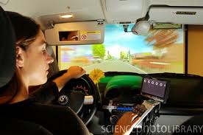
How does this concept fit with Research Administration?
Researchers drive the research enterprise
Notes:
Researchers
Drive the research enterprise
We are the researchers navigators
Leadership is needed but not to lead the institution
Our first priority is servant-leader is service, and earn the trust of those we hope to lead.

Slide 46
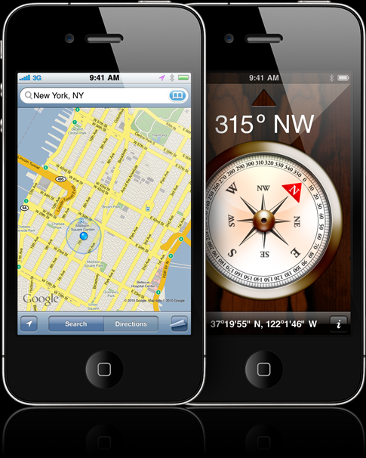
Research Administrators are the Navigators
Notes:
We are the researchers navigators
Leadership is needed but not to lead the institution
Our first priority is servant-leader is service, and earn the trust of those we hope to lead.

Slide 47
Servant-Leader
One of the most common definitions of serve is
to work for
to prepare
offer something to another
Consider, however, another definition of serve:
to be of assistance
to promote the interests of
fight for, or aid, another
Notes:
One of the most common definitions of serve is to work for, to prepare, and/or offer something to another. This definition is not inherently negative, although it can imply a lower status for the person serving.
Consider, however, another definition of serve: to be of assistance to, promote the interests of, fight for, or aid, another. This implies something further, a more noble purpose, and a sense of responsibility to others.

Slide 48
Earning Trust and Authority
our servant responsibilities to our researchers, to those who sponsor the research and the community as a whole, we have a far greater role as leaders in the research process:
Commitment to serve first.
Gains the customer/researcher trust and confidence.
Hierarchical authority no longer commands automatic respect; rather, respect that is given freely is needed to achieve real authority.
Our new and under-acknowledged role of leadership must be earned in order to be most effective.
Notes:
our servant responsibilities to our researchers, to those who sponsor the research and the community as a whole, we have a far greater role as leaders in the research process
By showing our commitment to serve first, we can provide the foundation needed for those we serve to also look to us as leaders.
By serving first, a great leader gains the trust and confidence of those he/she will lead.
Hierarchical authority no longer commands automatic respect; rather, respect that is given freely is needed to achieve real authority.
Our new and under-acknowledged role of leadership must be earned in order to be most effective.

Slide 49
Basic needs
As Greenleaf notes, one of the best ways to gain the trust needed to perform our jobs is to help ensure that our basic needs are met.

Slide 50
Typically, we would talk about Maslow’s Hierarchy of Needs

Slide 51
Basic Needs of researchers
But for our purposes, basic needs are:
administrative support
budgeting assistance
interpretation of guidelines
terms and conditions
proposal review, compliance and much more.
Guidance and support in these areas must be given by research administrators regardless of your level within the institution.
Please..help!
!
Notes:
But for our purposes, basic needs are:
administrative support
budgeting assistance
interpretation of guidelines
terms and conditions
proposal review, compliance and much more.
Guidance and support in these areas must be given by research administrators regardless of your level within the institution.

Slide 52
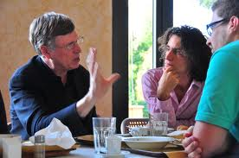
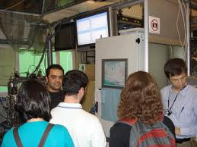
Building Relationships
Another way to gain trust and build a relationship is to demonstrate that you care about the person and his/her work.
Notes:
Another way to gain trust and build a relationship is to demonstrate that you care about the person and his/her work.
The research administrator can demonstrate respect by visiting researchers in their laboratories and offices, where they conduct the work we support, and learning about what it is that our researchers do.
Even though we may not understand the research, by showing an interest in it and even understanding a possible application or relationship between this research and other research, we show the researcher that we care about what they are doing.
This interaction can break down some barriers to communication whose existence may not have even been evident.

Slide 53
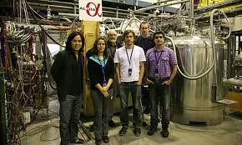
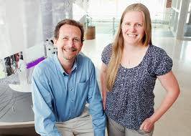
Visit researchers

Slide 54
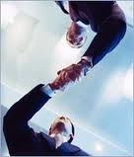
Building working Relationships
Research Administrator Role:
Subject Matter Experts (SME)
Facilitators
Translators & Interpreters
Mediators
Resources of knowledge
Notes:
By establishing strong working relationships with our researchers, we have an opportunity to build a relationship based on trust and respect.
This, too, allows us to lead, to be part of the solution, before a problem becomes critical. To truly play a leadership role in our field we must be proactive participants in the research process.

Slide 55
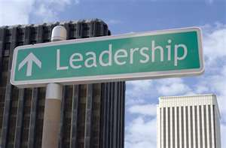
Leadership Role
As part of our leadership role, we are called upon to enforce policies, rules and regulations-sometimes will contradict the atmosphere of service needed in our profession.
Notes:
As part of our leadership role, we are called upon to enforce policies, rules and regulations. This can contradict the atmosphere of service needed in our profession. By gaining trust, showing our concern for those we serve, and building relationships, we can help to ensure that our messages are heard and understood as helpful assistance rather than obstacles to performing research. It is also important to remember that we are in fact providing good service when we enforce compliance and responsibility... even if it isn't always recognized.

Slide 56
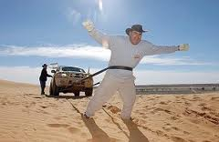
To overcome this obstacle we must:
gain the trust of the researcher
showing our concern for their work
Providing good service, when we
enforce compliance and responsibility
Notes:
By gaining trust, showing our concern for those we serve, and building relationships, we can help to ensure that our messages are heard and understood as helpful assistance rather than obstacles to performing research. It is also important to remember that we are in fact providing good service when we enforce compliance and responsibility... even if it isn't always recognized.

Slide 57
Serve and Lead
Greenleaf's servant leadership concept defines the essence of the profession of research administration.
We serve and we lead.
Notes:
Greenleaf's servant leadership concept defines the essence of the profession of research administration. We serve and we lead.
As we celebrate the profession of research administration, we recognize that the bottom line in our business is ultimately to improve society as a whole through the success of our researchers, and that our role is to guide this process by being both good servants and good leaders.

Slide 58
Servant Leadership & Research Administration
Devoted to meeting the needs of others
Focus efforts on bringing out the best in others
Coach others to express their talents
Facilitate the growth of those who work with them
Learn from the past, understand the present, foresee the consequences of future decisions
Listen and develop community of collaborators-researchers and research administrators
Acknowledgement: Robert K. Greenleaf “The Servant as Leaders” 1970; www.greenleaf.org (Greenleaf Center for Servant Leadership)

Slide 59
The Bottom Line
In our business is ultimately to improve society as a whole through the success of our researchers, and that our role is to guide this process by being both good servants and good leaders.
http://www.youtube.com/watch?v=mDVDXPo0ytM
Notes:
The bottom line in our business is ultimately to improve society as a whole through the success of our researchers, and that our role is to guide this process by being both good servants and good leaders.

Slide 60
The Paradoxical Commandments were written by Kent Keith in 1968, when he was 19, a sophomore at Harvard College. They were part of The Silent Revolution: Dynamic Leadership in the Student Council, his first booklet for high school student leaders
Notes:
In 1968, in the middle of student protests the world over, Kent Keith published a booklet for student leaders that included “The Paradoxical Commandments.” He wanted to support his fellow students by showing them that it was possible to get things done, even with
polar opposites:

Slide 61
People are illogical, unreasonable, and self-centered.
Love them anyway.
If you do good, people will accuse you of selfish ulterior motives.
Do good anyway.
If you are successful, you will win false friends and true enemies.
Succeed anyway.
Notes:
In 1968, in the middle of student protests the world over, Kent Keith published a booklet for student leaders that included “The Paradoxical Commandments.” He wanted to support his fellow students by showing them that it was possible to get things done, even with
polar opposites:

Slide 62
The Paradoxical Commandments of Leadership
The good you do today will be forgotten tomorrow.
Do good anyway.
Honesty and frankness make you vulnerable.
Be honest and frank anyway.
The biggest men and women with the biggest ideas can be shot down by the smallest men and women with the smallest minds.
Think big anyway.

Slide 63
The Paradoxical Commandments of Leadership
People favor underdogs but follow only top dogs.
Fight for a few underdogs anyway.
What you spend years building may be destroyed
overnight.
Build anyway.
People really need help but may attack you if you do help them.
Help people anyway.
Give the world the best you have and you’ll get kicked in the teeth.
Give the world the best you have anyway.

Slide 64
The “paradoxical commandments”
The “paradoxical commandments” describe perfectly what servant-leadership is all about.
According to Keith:
“by confronting the worst in the world with the best in ourselves. In the end, it is not the circumstances that determine how the world looks; it is our reactions—and these reactions can always be positive”!
.
Notes:
The “paradoxical commandments” describe perfectly what servant-leadership is all about. The message is clear: even in the most difficult situations, it is possible to find an alternative.
How? According to Keith, the answer is: by confronting the worst in the world with the best in ourselves. In the end, it is not the circumstances that determine how the world looks; it is our reactions—and these reactions can always be positive!

Slide 65
Questions or comments

Slide 66
References
Autry, J.A. (2001). The servant leader: How to build a creative team, develop great morale, and improve bottom-line performance. New York, NY: Three Rivers Press.
Erickson, S., Hansen, C., Howard, C-L, Norris, J.T., Wyatt Sedwick, S.,& Wilson, T.E. (2007). The role of research administration. Second edition. Washington, DC: National Council of University Research Administrators.
Greenleaf, R.K. (1991). Servant leadership: A journey into the nature of legitimate power and greatness. Mahwah, NJ: Paulist Press.
Krauser, P.A. (2003). The research administrator as servant-leader. The journal of research administration, volume xxxiv, number 1, (pp. 14-18).
Spears, L.C. (Ed.). (1995). Reflections on Leadership: How Robert K. Greenleaf's theory of servant-leadership influenced today's top management thinkers. New York, NY: John Wiley &
Sons, Inc.
Spears, L.C. (Ed.). (1998). Insights on Leadership: Service, Stewardship, Spirit and
Servant-Leadership. New York: John Wiley & Sons.
Trompenaars, F. & Voerman, E. (2010). Servant-Leadership across cultures: harnessing the strengths of the world’s most powerful management philosophy.New York, NY: McGraw-Hill.

Slide 67
UNDERSTANDING YOUR CLIENTS
Researcher Profile
Your Interface: Building a Strong Relationship
Exploring Research Administration…from CONCEPT to COMMERCIALIZATION
Laurianne Torres & Dr. Andrew Daire

Slide 68
UNDERSTANDING YOUR CLIENTS
Graduate Students
Have almost no real experience
May be running the lab
School-life balance
Going into debt
Future researchers
Rely heavily on major professor
Have no funding
Have likely never written a grant
Researcher Profile
INTRODUCTION TO SPARKS
Notes:
Research Administrator behavior is influenced by the organizational environment and each environment has its own variables. (Atkinson, Gilleland & Barrett, 2007)
The interests of the organization and its members need to be aligned.
The leader is one of the vital members of the organization, and the research administrator as professional is a default leader when it comes to research and grant functions.
Research Administrators, as professional leaders, sit at the intersection between academic and administrative organizational behaviors.
Research administrators must cope with increased amounts of stress, seek legitimacy through credentialing and work in a context in which there seem to be varying degrees of support.
Research administrators are required to be savvy and use leadership skills that promote collaboration, the individual and the intellect because information produced by the organization is ever-changing and fluid.

Slide 69
UNDERSTANDING YOUR CLIENTS
Postdoctoral Associates (Postdocs)
Short training period
Generally right out of a dissertation
Rarely (if ever) get their own funding
In lab for 2-3 years, then out
Laboratory slaves
Pay is marginal
Debt is great
Family?
Researcher Profile
INTRODUCTION TO SPARKS
Notes:
Research Administrator behavior is influenced by the organizational environment and each environment has its own variables. (Atkinson, Gilleland & Barrett, 2007)
The interests of the organization and its members need to be aligned.
The leader is one of the vital members of the organization, and the research administrator as professional is a default leader when it comes to research and grant functions.
Research Administrators, as professional leaders, sit at the intersection between academic and administrative organizational behaviors.
Research administrators must cope with increased amounts of stress, seek legitimacy through credentialing and work in a context in which there seem to be varying degrees of support.
Research administrators are required to be savvy and use leadership skills that promote collaboration, the individual and the intellect because information produced by the organization is ever-changing and fluid.

Slide 70
UNDERSTANDING YOUR CLIENTS
Researcher Profile
6 years to become an asset
Many are called; few are chosen
Job security
May be offered out of the gate
A permanent home
Commitment
Longevity
What is Tenure?
INTRODUCTION TO SPARKS
Notes:
Research Administrator behavior is influenced by the organizational environment and each environment has its own variables. (Atkinson, Gilleland & Barrett, 2007)
The interests of the organization and its members need to be aligned.
The leader is one of the vital members of the organization, and the research administrator as professional is a default leader when it comes to research and grant functions.
Research Administrators, as professional leaders, sit at the intersection between academic and administrative organizational behaviors.
Research administrators must cope with increased amounts of stress, seek legitimacy through credentialing and work in a context in which there seem to be varying degrees of support.
Research administrators are required to be savvy and use leadership skills that promote collaboration, the individual and the intellect because information produced by the organization is ever-changing and fluid.

Slide 71
UNDERSTANDING YOUR CLIENTS
Assistant Professors
Have little real experience
Are a drain until funded
Nervous about tenure
Higher teaching load
Not all will get tenure
Have little to no internal support system
Have no funding
May have never written a grant
Researcher Profile
INTRODUCTION TO SPARKS
Notes:
Research Administrator behavior is influenced by the organizational environment and each environment has its own variables. (Atkinson, Gilleland & Barrett, 2007)
The interests of the organization and its members need to be aligned.
The leader is one of the vital members of the organization, and the research administrator as professional is a default leader when it comes to research and grant functions.
Research Administrators, as professional leaders, sit at the intersection between academic and administrative organizational behaviors.
Research administrators must cope with increased amounts of stress, seek legitimacy through credentialing and work in a context in which there seem to be varying degrees of support.
Research administrators are required to be savvy and use leadership skills that promote collaboration, the individual and the intellect because information produced by the organization is ever-changing and fluid.

Slide 72
UNDERSTANDING YOUR CLIENTS
Researcher Profile
Associate Professors
Tenured (generally)
Determine fate of Assistant Professors
Have publications and some funding
Successful, if still here
Fit into department
Growing lab
Increased funding pressure
Increased publication pressure
INTRODUCTION TO SPARKS
Notes:
Research Administrator behavior is influenced by the organizational environment and each environment has its own variables. (Atkinson, Gilleland & Barrett, 2007)
The interests of the organization and its members need to be aligned.
The leader is one of the vital members of the organization, and the research administrator as professional is a default leader when it comes to research and grant functions.
Research Administrators, as professional leaders, sit at the intersection between academic and administrative organizational behaviors.
Research administrators must cope with increased amounts of stress, seek legitimacy through credentialing and work in a context in which there seem to be varying degrees of support.
Research administrators are required to be savvy and use leadership skills that promote collaboration, the individual and the intellect because information produced by the organization is ever-changing and fluid.

Slide 73
UNDERSTANDING YOUR CLIENTS
Researcher Profile
Professors
&
Endowed Professors
Old established
Changing rules, changing science
Has a Reputation to Uphold
Publications
Continued funding
Competitive
Pushy
INTRODUCTION TO SPARKS
Notes:
Research Administrator behavior is influenced by the organizational environment and each environment has its own variables. (Atkinson, Gilleland & Barrett, 2007)
The interests of the organization and its members need to be aligned.
The leader is one of the vital members of the organization, and the research administrator as professional is a default leader when it comes to research and grant functions.
Research Administrators, as professional leaders, sit at the intersection between academic and administrative organizational behaviors.
Research administrators must cope with increased amounts of stress, seek legitimacy through credentialing and work in a context in which there seem to be varying degrees of support.
Research administrators are required to be savvy and use leadership skills that promote collaboration, the individual and the intellect because information produced by the organization is ever-changing and fluid.

Slide 74
UNDERSTANDING YOUR CLIENTS
Researcher Profile
Competitive recruitment
No security
High expectations
Great science
Pay own salary
Support own lab
Publish
Pay debts
Have a life
Get funding
Train students
Why be Faculty?
INTRODUCTION TO SPARKS
Notes:
Research Administrator behavior is influenced by the organizational environment and each environment has its own variables. (Atkinson, Gilleland & Barrett, 2007)
The interests of the organization and its members need to be aligned.
The leader is one of the vital members of the organization, and the research administrator as professional is a default leader when it comes to research and grant functions.
Research Administrators, as professional leaders, sit at the intersection between academic and administrative organizational behaviors.
Research administrators must cope with increased amounts of stress, seek legitimacy through credentialing and work in a context in which there seem to be varying degrees of support.
Research administrators are required to be savvy and use leadership skills that promote collaboration, the individual and the intellect because information produced by the organization is ever-changing and fluid.

Slide 75
UNDERSTANDING YOUR CLIENTS
Your Interface: Building a Strong Relationship
Grant submissions
3/year, now 5-6/year
Original ideas
Lab support
Deadlines
Competition
A ton of work
40 pages of grant to write
Budgets
IRB/IACUC
Departmental signatures
Relevance
Promotion
Compliance
4:55 pm proposal
Electronic submissions
Deadlines
A ton of work
40 pages of grant to review
Budgets
Approvals
Politics
Cost share
Guidelines
Coordination
Conflicting priorities
Researcher
Research
Administrator
INTRODUCTION TO SPARKS

Slide 76
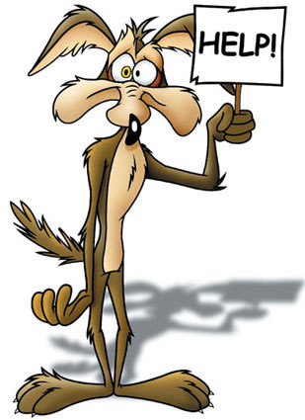
UNDERSTANDING YOUR CLIENTS
Your Interface: Building a Strong Relationship
Transforming the Relationship through Collegiality
A Mutual Respect
It is about Help
PhDs forget they might not know
I hate to be dumb
The system changes daily
New policies, New forms
Process can be painful
What is obvious to us isn’t to our customers
How we did it 20 years ago changed
INTRODUCTION TO SPARKS

Slide 77
QUESTIONS or COMMENTS?

Slide 78
THANKS FOR JOINING US!
See you at the next session:
IDEA FORMATION
May 16, 2012
10:00 am to 12:00 pm
Sponsored Programs Administration Resource & Knowledge Series

